Slide 1
Essential Question:
Why is historiography important and how can it be used?

Slide 2
Historiography- the study of how history is written & its various perspectives / biases

Slide 3
Central idea:
Facts are integral to the study of history, but equally important is the meaning we give historical information

Slide 4
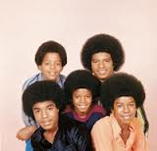

Example

Slide 5

Motown Remixed

Slide 6
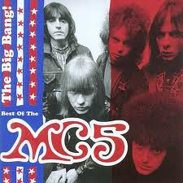
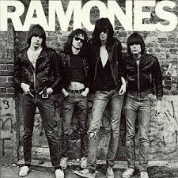
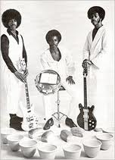

VS

Slide 7
P
E
R
M
S

Slide 8
P
E
R
S
I
A
N

Slide 9
Dominant Schools of Historiography
Consensus or traditional-
Argues that change results from consensus among various groups in society.
Division & class interest, etc. exist but are not central to the process of change.

Slide 10
Conflict or revisionist-
Opposite view
It views conflict among groups, classes, race, and gender, etc. as central to the process of change.

Slide 11

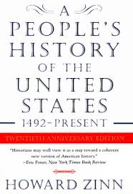
2 Examples

Slide 12
Types of History
Social
Political
Economic
Diplomatic
Military
Constitutional
Marxist / Conflict
Gender
Eurocentric
Afrocentric
Environmental Determinism

